Slide 1


CREDIT CARD DEFAULTERS CLASSIFICATION
MATHEMATICS IN MACHINE LEARNING
LUCA CAMPANA
A.A. 2021-22

Slide 2
DATASET EXPLORATION
1

Slide 3
DATASET EXPLORATION – OVERVIEW
1
Default of Credit Card Clients^{[1]}: 30 000 samples, 0 null values, 35 duplicated rows (removed)
Target variable: binary (1 for defaulters, 0 otherwise)
23 explainatory variables:
Numerical | Categorical
LIMIT_BAL (NT$) | SEX (2 categories)
AGE (years) | EDUCATION (7 categories, 3 unknown*)
BILL_AMT_1 – BILL_AMT_6 (NT$) | MARRIAGE (4 categories, 1 unknown*)
PAY_AMT_1 – PAY_AMT_6 (NT$) | PAY_1 – PAY_6 (12 categories, 3 unknown*)

Slide 4
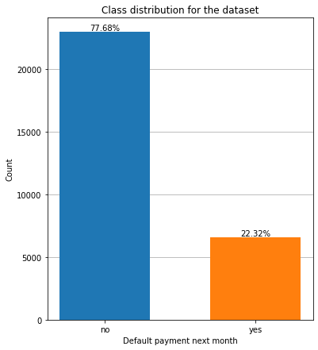
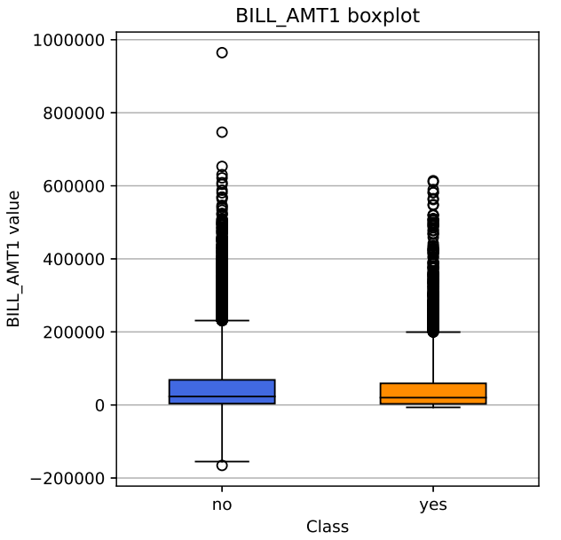
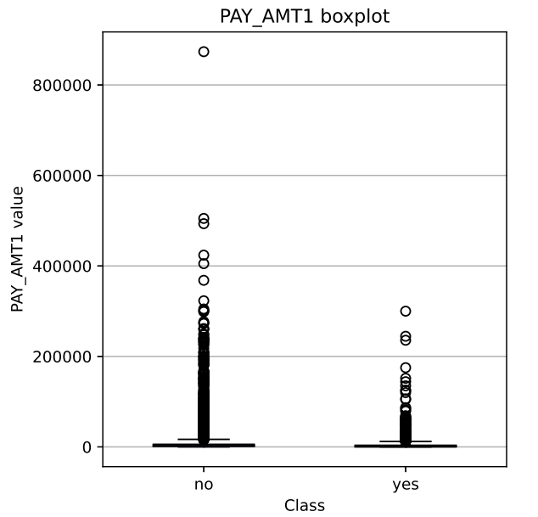
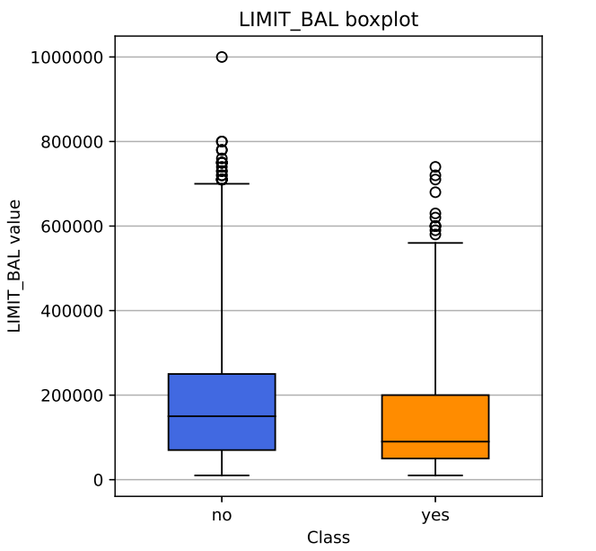
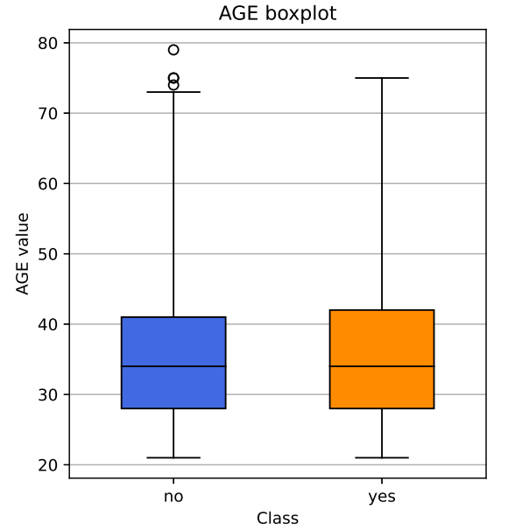
DATASET EXPLORATION – variables distribution
1
Target variable: heavy unbalancing (78% negative samples)
Numerical variables: lots of outliers

Slide 5
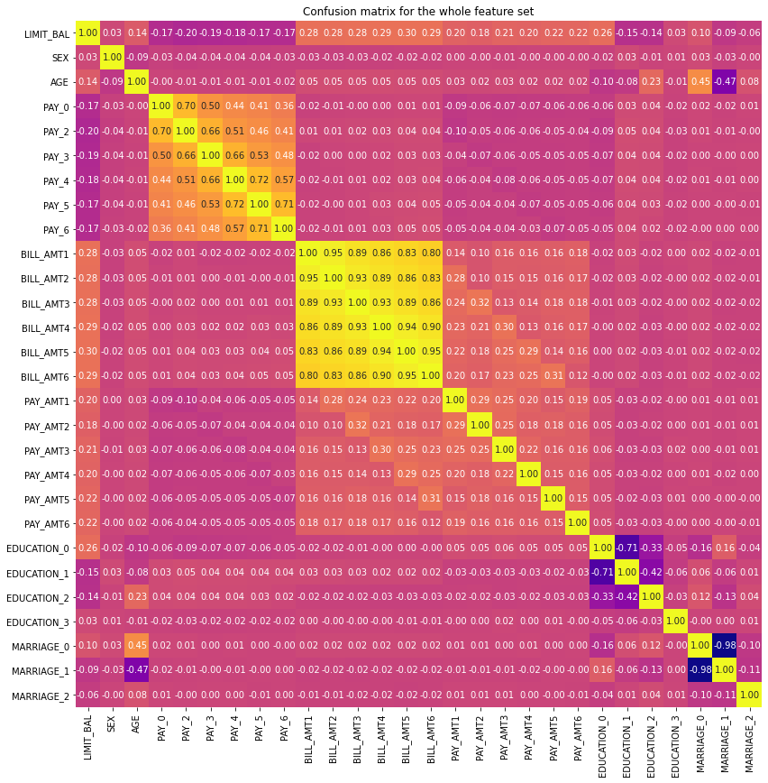
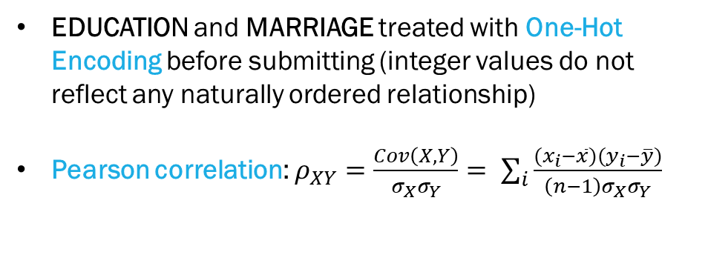
DATASET EXPLORATION – correlation analysis
1
EDUCATION and MARRIAGE treated with One-Hot Encoding before submitting (integer values do not reflect any naturally ordered relationship)
Pearson correlation: $ρ_{XY}=\frac{Cov\left(X,Y\right)}{σ_{X}σ_{Y}}= \sum_{i}{\frac{(x_{i}−\overline{x})(y_{i}−\overline{y})}{\left(n−1\right)σ_{X}σ_{Y}}}$
Considerable correlation between BILL_AMT_i fields; also, between EDUCATION_0-1 and MARRIAGE_0-1
Fields removed: BILL_AMT_2-3-4-5-6; MARRIAGE_1; EDUCATION_1

Slide 6
DATA PREPOCESSING
2

Slide 7
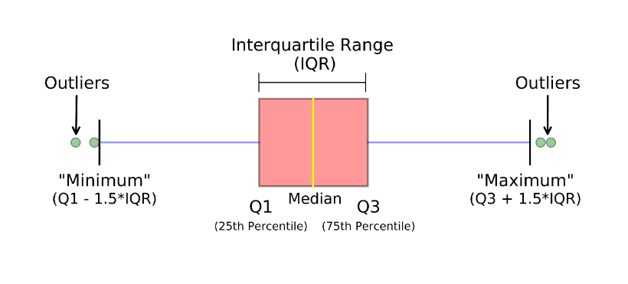
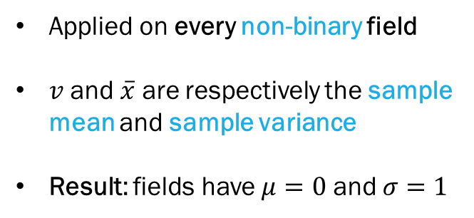
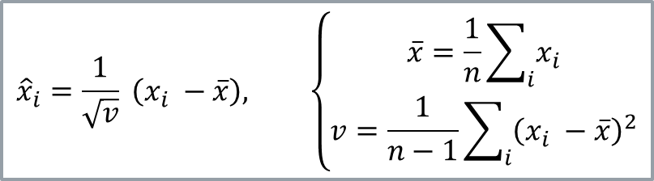
DATA PREPROCESSING – OUTLIERS MANAGEMENT AND NORMALIZATION
2
BOX-PLOT METHOD
STANDARD SCALING
$${\hat{x}}_{i}=\frac{1}{\sqrt{v}} \left(x_{i} −\overline{x}\right), \left\{\begin{aligned}\overline{x}=\frac{1}{n}\sum_{i}{x_{i}} \\ v=\frac{1}{n−1}\sum_{i}{{\left(x_{i} −\overline{x}\right)}^{2}}\end{aligned}\right.$$
Applied on every numerical field
Whiskers placed at 2.5*IQR
Result: 7 104 rows removed
Applied on every non-binary field
$v$ and $\overline{x}$ are respectively the sample mean and sample variance
Result: fields have $μ=0$ and $σ=1$

Slide 8
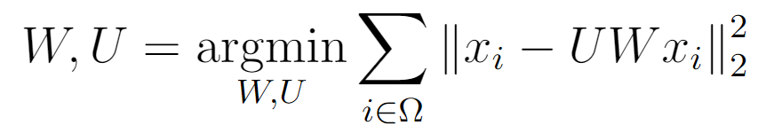
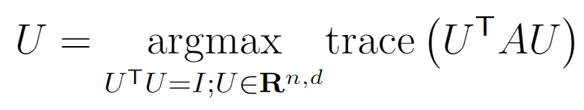
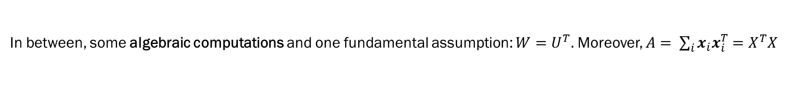
DATA PREPROCESSING – principal component analysis (1/2)
2
Rationale: represent the dataset in a less-dimensional sample space, easier to be used in computations
Based on calculating the compression matrix $W∈ℝ^{d,n}$and the recovering matrix $U ∈{ ℝ}^{n,d}$ such that $\tilde{x}=Wx$
ORIGINAL OPTIMIZATION PROBLEM
SIMPLIFIED OPTIMIZATION PROBLEM
In between, some algebraic computations and one fundamental assumption: $W=U^{T}.$ Moreover, $A= \sum_{i}{x_{i}x_{i}^{T}}=X^{T}X$
$U$ columns are the $d$leading eigenvectors of the matrix $A$; the whole problem turns into evaluating eigenvectors.

Slide 9
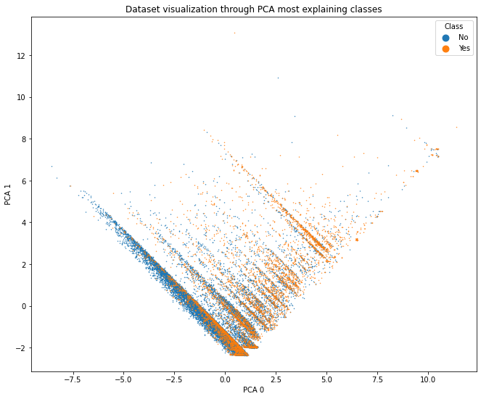
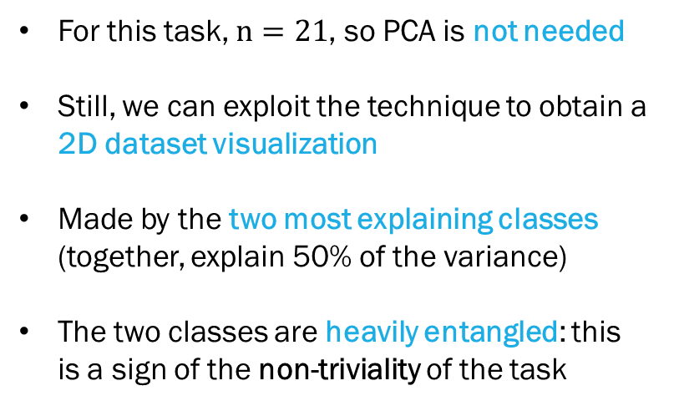
DATA PREPROCESSING – principal component analysis (2/2)
2
For this task, $n=21$, so PCA is not needed
Still, we can exploit the technique to obtain a 2D dataset visualization
Made by the two most explaining classes (together, explain 50% of the variance)
The two classes are heavily entangled: this is a sign of the non-triviality of the task

Slide 10
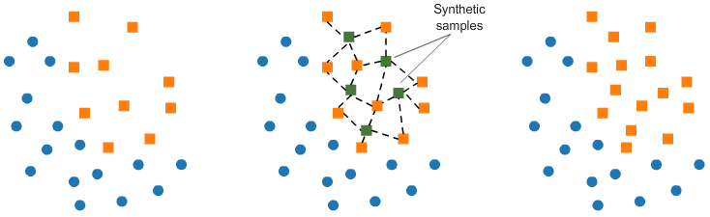
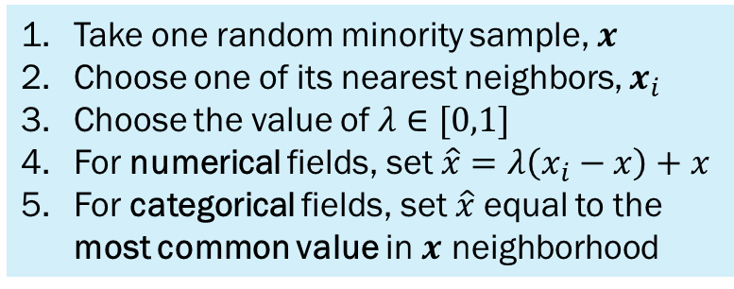
DATA PREPROCESSING – smote
2
Oversampling technique, to overcome dataset unbalancing
Fairly better than undersampling and oversampling with replacement
Rationale: generate synthetic samples for minority class, along the lines that connect existing samples
For categorical fields, we need not to lose semantics: SMOTE-NC allows to treat properly both nominal and continuous categories
Result: creating a larger and less specific decision region for the minority class
SMOTE-NC PSEUDOALGORITHM
Take one random minority sample, $x$
Choose one of its nearest neighbors, $x_{i}$
Choose the value of $λ∈[0,1]$
For numerical fields, set $\hat{x}=λ\left(x_{i}−x\right)+x$
For categorical fields, set $\hat{x}$equal to the most common value in $x$ neighborhood

Slide 11
methodology
3

Slide 12

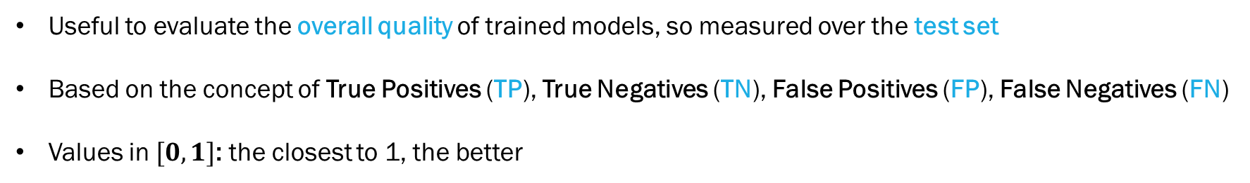

Methodology – assessed metrics
3
Useful to evaluate the overall quality of trained models, so measured over the test set
Based on the concept of True Positives (TP), True Negatives (TN), False Positives (FP), False Negatives (FN)
Values in $[0,1]$: the closest to 1, the better
$$accuracy=\frac{TP+TN}{TP+TN+FP+FN}$$
$$f1 score=\frac{2TP}{2TP+FP+FN}$$
Other possible metrics could be precision and recall
Various levels of interpretability and influence from dataset unbalancing

Slide 13
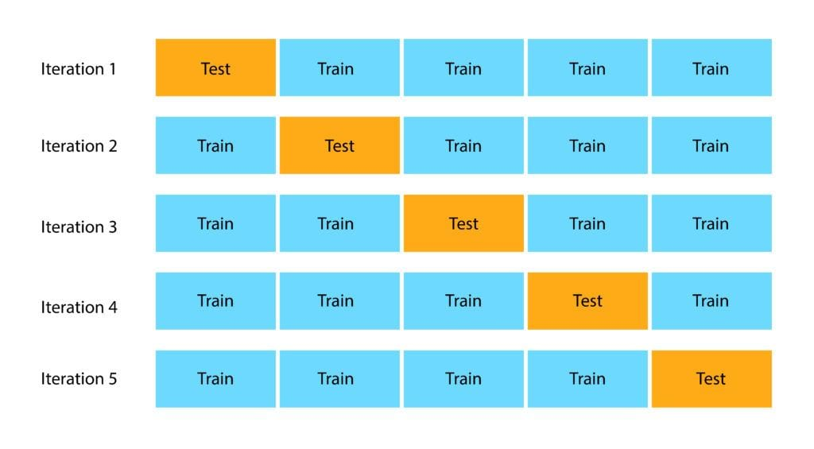
Methodology – k-fold cross validation
3
Rationale: evaluate performances in a consistent way, without wasting training samples
How it works: split dataset into $k$folds, then do $k$independent trainings (1 fold as test set, the others as training set)
Each sample is treated once as a test sample, and $(k−1)$ times as training sample. No data wasting!
Final metrics are obtained as the average of each fold. Best tradeoff between model variance and bias.

Slide 14
Classification models
4

Slide 15

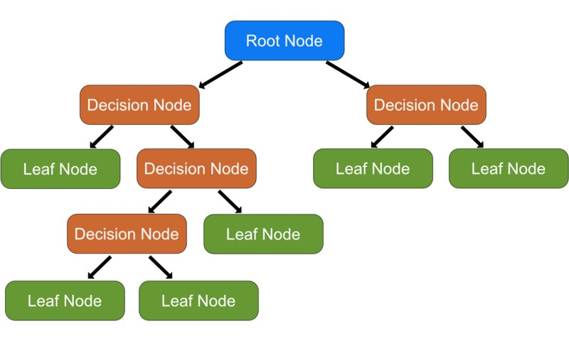

Classification models – decision tree
4
Rationale: find splitting rules (based on features values) to separate target classes
Concretely done in a greedy fashion, evaluating the quality of the local split (i.e. comparing the father node and the potential children in terms of their impurity, measured with indices like GINI or entropy)
Traits:
excellent interpretability
slow building
fast inference

Slide 16
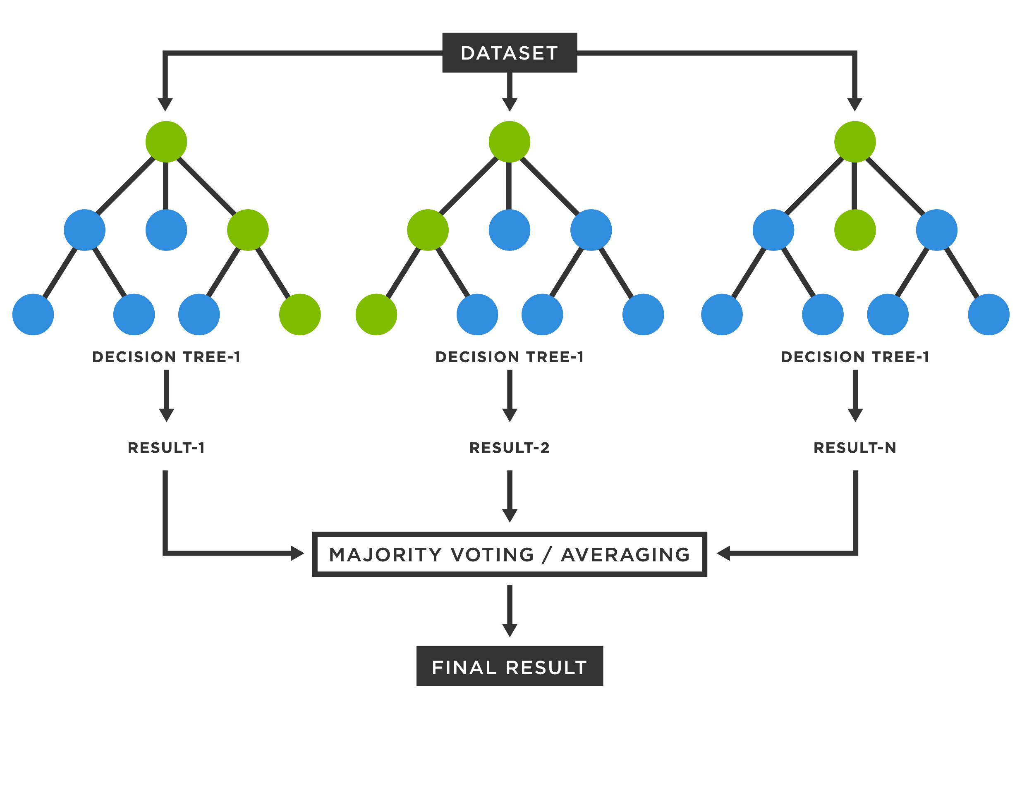
Classification models – random forest
4
Rationale: overcome DT drawbacks by ensembling (a class is always smarter than its smartest student)
Grow a set of decision trees; train them separately; produce final classification with a majority vote from all trees
Reduce the variance problem through bagging approach: each of the trees is trained with a random subset of the samples, over a random subset of features
Produce a set of decorrelate trees, and consequently a more robust model
Traits:
reduced interpretability
optimizable building (exploiting parallelism)
fast inference

Slide 17

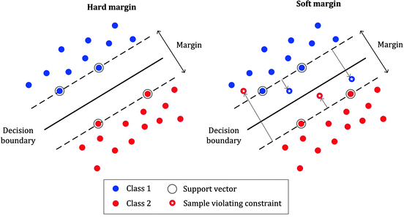
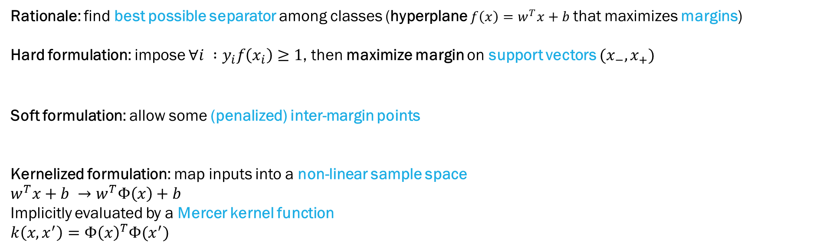
Classification models – support vector machine
4
Rationale: find best possible separator among classes (hyperplane $f\left(x\right)=w^{T}x+b$that maximizes margins)
Hard formulation: impose ${∀i :y}_{i}f\left(x_{i}\right)≥1$, then maximize margin on support vectors $(x_{−}, x_{+})$
Soft formulation: allow some (penalized) inter-margin points
Kernelized formulation: map inputs into a non-linear sample space
$w^{T}x+b →w^{T}Φ\left(x\right)+b$
Implicitly evaluated by a Mercer kernel function
$k\left(x,x^{′}\right)=Φ{\left(x\right)}^{T}Φ(x^{′})$
Traits:
nearly null interpretability
slow building (finding SVs)
istantaneous inference

Slide 18
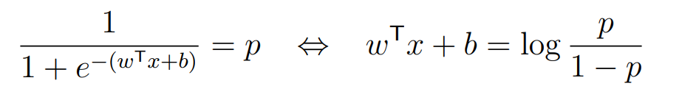
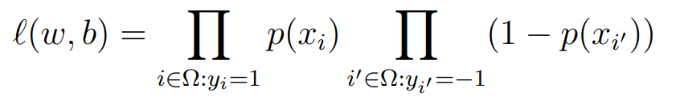
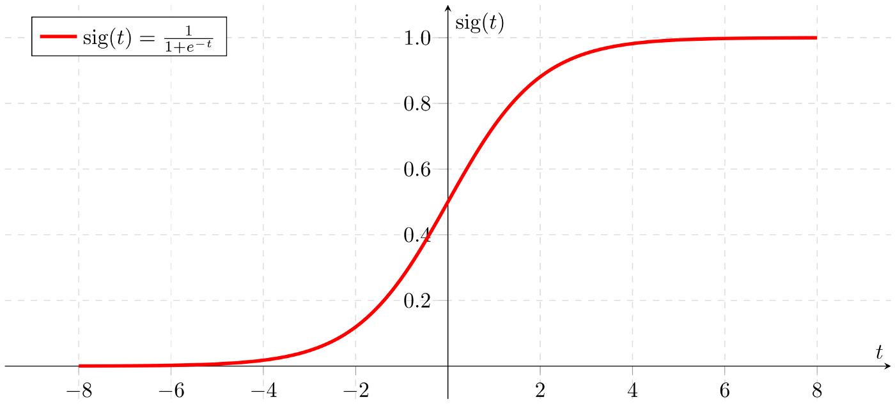
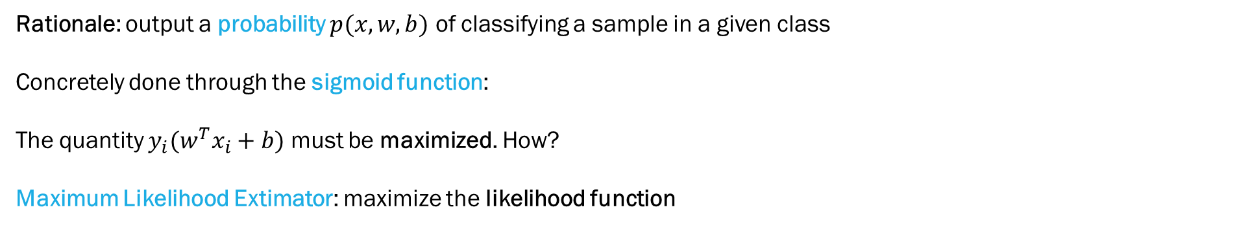
Classification models – logistic regression
4
Rationale: output a probability $p(x,w,b)$ of classifying a sample in a given class
Concretely done through the sigmoid function:
The quantity $y_{i}(w^{T}x_{i}+b)$ must be maximized. How?
Maximum Likelihood Extimator: maximize the likelihood function
Traits:
discrete interpretability
fast building
istantaneous inference

Slide 19
Results and conclusions
5

Slide 20
Results and conclusions – training overwiew
5
MODEL | TRIED HYPERPARAMETERS | FOUND HYPERPARAMETERS | K-FOLD ACCURACY | K-FOLD F1-SCORE
Decision Tree | criterion: [’gini’, ’entropy’] max_depth: [None, 10] | criterion: ’entropy’ max_depth: None | 0,677 | 0,424
Random Forest | n_estimators: [100, 200] criterion: [’gini’, ’entropy’] max_depth: [None, 10] | n_estimators: 200 criterion: ’entropy’ max_depth: None | 0,776 | 0,532
Support Vector Machine | penalty: [’l1’, ’l2’] C: [1, 2] | penalty: ‘l2’ C: 1 | 0,765 | 0,553
Logistic Regression | penalty: [’l1’, ’l2’] C: [1, 2] | penalty: ‘l1’ C: 2 | 0,761 | 0,556

Slide 21
External references
5
I-Cheng Yeh. Default of credit card clients Data Set.
__ https://archive.ics.uci.edu/ml/datasets/default+of+credit+card+clients, 2009.
James Gareth, Witten Daniela, Hastie Trevor, Tibshirani Robert. An Introduction to Statistical Learning with Applications in R. James, Witten, Hastie & Tibshirani, 2013.
Shalev-Shwartz Shai, Ben-David Shai. Understanding Machine Learning: From Theory to Algorithms. Cambridge University Press, 2014.

